Slide 1
Identification of influential users in social network using optimization algorithms
IT752 WSC - Mini-project End Sem Evaluation [Jan-Apr 2023]
Base paper: Identification of influential users in social network using gray wolf optimization algorithm
Link: https://doi.org/10.1016/j.eswa.2019.112971
Presented By:
Amrit Mohapatra 222IT004
Natasha Jain 222IT023

Slide 2
Contents
Introduction
Literature Survey
Outcome of Literature Survey
Problem Statement and Objectives
Existing Methodology
Dataset details
Exploratory Data Analysis
Proposed enhancements/novelty
Work done
Experiments and Results
Comparison with base paper
Conclusion and Future Work
Individual Contribution
References

Slide 3
Introduction
Social networks have become an essential part of our daily lives, with billions of people connected through various platforms.
As social networks grow in popularity, the analysis of these networks has become increasingly important for understanding social behavior, identifying key actors, and developing effective marketing strategies.
One of the critical aspects of social network analysis is the identification of influential users who can have a significant impact on the network's overall behavior.
In recent years, metaheuristic optimization algorithms have gained popularity in social network analysis.
In this paper we have analysed the different optimization algorithms- GWO,PSO,GA in order to determine which one is most effective in finding the influential users in social media.

Slide 4
Literature Review
Author/year | Methodology | Advantages | Limitations
L. Han, Q. Zhou, J. Tang, X. Yang and H. Huang, Year :2021 [1] | Identifying the top-k influential nodes in a network using a combination of discrete particle swarm optimization and local neighborhood degree centrality | The proposed method is able to identify the most influential nodes in a network with high accuracy. The use of local neighborhood degree centrality allows for a more nuanced understanding of the role that individual nodes play within a network. | The method is reliant on the assumption that the most influential nodes in a network have high degree centrality. While this is often true, it may not hold in all cases.
Michał Weskida, Radosław Michalski Year:2019 [2] | Representing candidate solutions as binary vectors, using a fitness function to evaluate the influence of each candidate solution, and applying selection, crossover, and mutation operations to produce new candidate solutions | The use of evolutionary algorithms allows for a flexible and adaptive approach to identifying influential nodes, which can be particularly useful in dynamic networks. | The algorithm may require a large number of iterations to converge to a solution, which can make it computationally expensive. It assumes that the most influential nodes are those that are well-connected within the network
Ahmad Zareie,Amir Sheikhahmadi,Mahdi Jalili [3] Year :2020 | The method involves representing each candidate solution as a binary vector, using a fitness function that considers both degree centrality and betweenness centrality to evaluate the influence of each solution | The GWO algorithm is a metaheuristic optimization algorithm that is known for its ability to find optimal solutions quickly and efficiently. The method is able to handle large and complex networks. | The method may be sensitive to the choice of optimization parameters, such as the number of wolves and the maximum number of iterations.

Slide 5
Outcome of Literature Review
Measures of centrality, such as degree centrality, betweenness centrality, and eigenvector centrality, are frequently applied in the process of locating influential users on the basis of their locations in the network.
It has been demonstrated that these measurements are successful in identifying prominent users in social networks.
They do have certain limitations, such as the inability to take into consideration dynamic changes in the network.
Optimization algorithms have been presented as a solution to solve these restrictions. These research have demonstrated that optimization algorithms are capable, based on centrality metrics and network architecture, of effectively identifying prominent members inside social networks.
However, the efficacy and efficiency of these algorithms is contingent on the particular attributes of the optimization algorithm as well as the social network.

Slide 6
Problem Statement
The purpose of this research is to optimize the selection of seed nodes in a social network in order to maximize their influence using the ICM.
Research Objectives
We formulate the influence maximization problem as an optimization problem with cost functions as the influentiality of the nodes and the distance between them.
The goal of IM problem is to identify a set S with k members to initiate the spreading process so that the spread is maximized, i.e. the number of activated users is maximized.
To Maximize the distance between the seed nodes that guarantees reaching to different parts of the network.
We use gray wolf optimization algorithm, particle swarm optimization algorithm and genetic algorithm to solve the problem.
To lower the computational time than other meta-heuristic methods.

Slide 7
Existing Methodology
Initialize the population of Gray wolves
Evaluate the fitness of each Gray wolf
Identify the 3 types of Gray wolves: alpha, beta, and delta
Update the position of each Gray wolf on its type and position of other wolves
Apply any constraints or boundaries to the positions of the Gray wolves
Evaluate the new positions of the grey wolves.
Update the alpha, beta, and delta wolves based on their fitness and position
Repeat the steps 4 to 7 until maximum no of iterations is reached
Return the best solution found by the grey wolves as the optimal solution
Flow Chart of Gray Wolf Optimization Algorithm(GWO)
In the GWO we consider the fittest solution as alpha, second and third fittest solution as beta and delta respectively.

Slide 8
Social Dominant Hierarchy of Gray Wolves
Contd..
Alpha
Alpha Wolves update their position by chasing prey i.e., the best solution so far.
Beta Wolves update their position by following the alpha wolf.
Delta Wolves update their position by following the beta wolf.
Omega wolves update their position randomly within search space.
Beta
Delta
Omega

Slide 9
Datasets
Hamsterster full : This Network contains friendships and familylinks between users of the website hamsterster.com. http://konect.cc/networks/petster-hamster/
Pretty Good Privacy: This is the interaction network of users of the Pretty Good Privacy (PGP) algorithm. http://konect.cc/networks/arenas-pgp//arenas-pgp/
AstroPH: This network dataset is in the category of Collaboration Networks https://networkrepository.com/ca-AstroPh.php
Exploratory Data Analysis
 | Hamsterster(HAM) | Pretty Good Privacy(PGP) | AstroPH
Type | Undirected Graph | Undirected Graph | Undirected Graph
No of Nodes | 2426 | 10680 | 17903
No of Edges | 16631 | 24316 | 196972

Slide 10



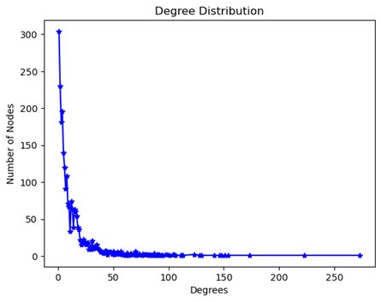
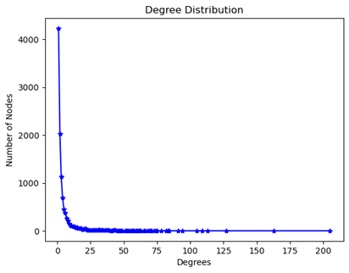
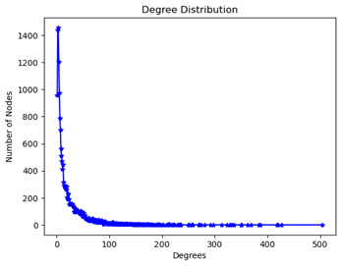
Exploratory Data Analysis(Cont)
Representation
Degree Distribution
Average path length | 1.40729 | 7.48554 | 4.1940
Clustering Coefficient | 0.5376 | 0.26594 | 0.6328
Average diameter | 10 | 24 | 14

Slide 11
Proposed enhancements/novelty
We have evaluated two other novel optimisation algorithms – Particle Swarm Optimization algorithm and Genetic Algorithm to optimise the influence of seed nodes in the social network are the most influential nodes.
We have compared the fitness values of three cutting edge algorithms to determine which algorithm has the maximum influence.

Slide 12
Particle Swarm Optimization algorithm
Initialize the population of particles with random positions and velocities
Evaluate the fitness of each particle by applying objective function to its position
Identify the particle with best fitness(i.e., the global best)
Update the velocity of each particle based on its previous velocity, its position and the position of global best
Apply any constraints or boundaries to the positions and velocities of the particles
Update the position of each particle based on its velocity
Evaluate the fitness of the new positions of the particles
Update the particle with best fitness(global best) and Repeat steps 4 to 8 until max iterations
Return the best solution found by the particles as the optimal solution
Flow Chart of Particle Swarm Optimization algorithm (PSO)
Each particle in search space adjusts its ― movement according to its own moving experience as well as the moving experience of other particles.

Slide 13
Genetic Algorithm
Initialize the population of individuals randomly
Evaluate the fitness of each individual by applying objective function to its genes
Select the fittest individuals to be parents based on their fitness
Generate new offspring by applying genetic operators to the selected parents
Apply any constraints or boundaries to the genes of the offspring
Evaluate the fitness of the new offspring
Select a subset of the offspring and existing individuals to create the next generation
Apply elitism to keep and select best individuals from prev gen and Repeat steps 4 to 8 until max iterations
Return the best solution found by the individuals as the optimal solution
Flow Chart of Genetic algorithm (GA)
The algorithm involves creating a population of candidate solutions (i.e., chromosomes), evaluating their fitness, and applying genetic operators such as selection, crossover, and mutation to generate new offspring solutions that are hopefully better than their parents.

Slide 14
Work done
Data collection and analysis
Performed Gray wolf optimization on all the three dataset
Plotted the graph of fitness and found the best solution.
Performed Particle Swarm Optimization on all datasets
Plotted the graph of fitness and found the optimal solution.
Performed Genetic Algorithm on the datasets
Plotted the graph of fitness and found the optimal solution of seed set.
Compared the results of all the 3 proposed optimisation algorithms.
Analysed the results found.

Slide 15
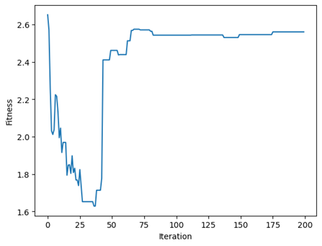
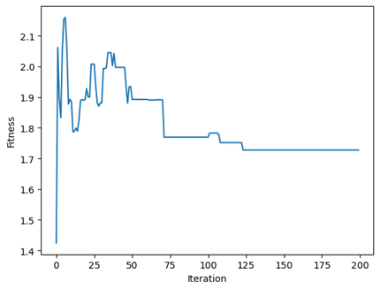
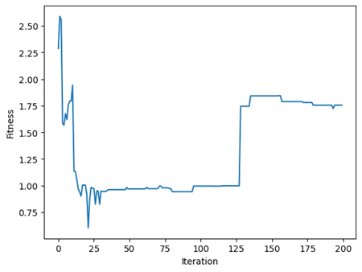
Experiments and Results
Gray Wolf Optimisation
Fitness Graph of HAM Dataset
Fitness Graph of PGP dataset
Fitness Graph of Astro dataset

Slide 16
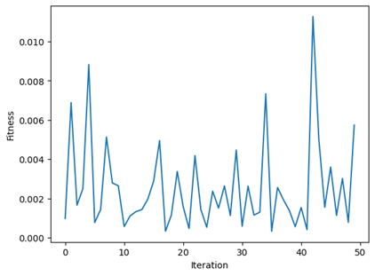
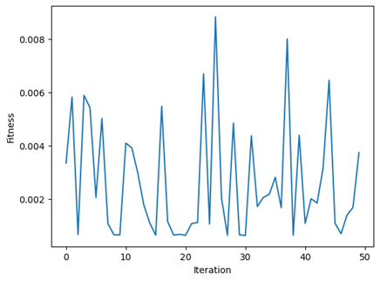
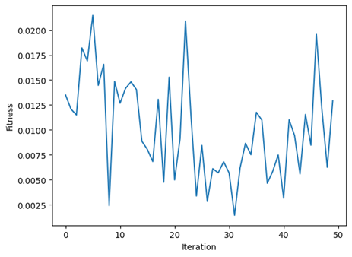
Experiments and Results
Particle Swarm Optimisation
Fitness Graph of HAM Dataset
Fitness Graph of PGP dataset
Fitness Graph of Astro dataset

Slide 17
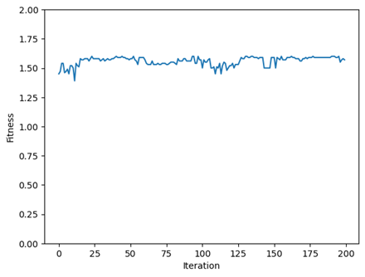
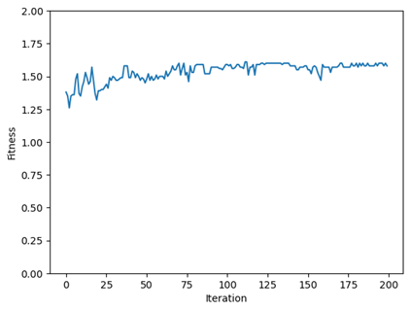
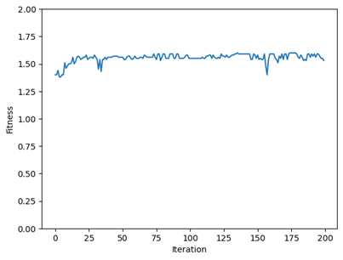
Experiments and Results
Genetic Algorithm
Fitness Graph of HAM Dataset
Fitness Graph of PGP dataset
Fitness Graph of Astro dataset

Slide 18
Comparison with base paper
The findings demonstrated that the algorithm based on PSO consistently performed better than the methods based on GWO and GA across all three networks.
When applied to the Hamsterster complete network, the PSO-based approach was able to perform faster and better on more impacted nodes than the GWO algorithm and GA algorithm respectively.
Similarly, when applied to the Pretty Good Privacy network, the PSO-based approach outperforms GWO and GA in terms of performance speed and fitness.
When applied to the Astro network, the PSO-based approach achieved better fitness in lesser time in comparison to GWO and GA. This was in comparison to the other two algorithms.

Slide 19
Conclusion and Future Work
When compared to the GWO and GA algorithms, the results reveal that the PSO-based algorithm is the most successful in maximizing influence in social networks.
In future we will extend the influential maximization algorithms to take into consideration dynamic social networks, in which both the topology of the network and the qualities of the nodes vary over the course of time.
In future we will test the robustness of the influential maximization methods under different kinds of attacks (for example, the targeted removal of nodes)

Slide 20
Individual Contribution
Background study , data collection and analysis [NATASHA]
Implementing Gray Wolf Optimisation Algorithm [AMRIT]
Implemented Particle Swarm Optimisation [NATASHA]
Implemented Genetic Algorithm [AMRIT]
Compared the results and plotted the graphs [NATASHA,AMRIT]

Slide 21
References
[1]. ZL. Han, Q. Zhou, J. Tang, X. Yang and H. Huang, "Identifying Top-k Influential Nodes Based on Discrete Particle Swarm Optimization With Local Neighborhood Degree Centrality," in IEEE Access, vol. 9, pp. 21345-21356, 2021, doi: 10.1109/ACCESS.2021.3056087
[2] Weskida, M., & Michalski, R. (2019, February). Finding influentials in social networks using evolutionary algorithm. Journal of Computational Science, 31, 77–85. https://doi.org/10.1016/j.jocs.2018.12.010.
[3]. Zareie, A., Sheikhahmadi, A., & Jalili, M. (2020). Identification of influential users in social network using Gray Wolf Optimization algorithm. Expert Systems with Applications, 142, 112971. https://doi.org/10.1016/j.eswa.2019.112971

Slide 22
THANK YOU

